Slide 1

Srilasya Garigipaty DATA 1204 Linear Regression Student # 100822953

Slide 2
Hypothesis Statement
In this Linear Regression Analysis, the predictor (or independent) variable will be “dividend” and the
variable being predicted(dependent) variable will be “stock_return_scaled” from ols stocks dataset.
Null Hypothesis
Ho: A relationship between dividend and stock_return_scaled doesn’t exist.
Alternate Hypothesis
Ha: A relationship between dividend and stock_return_scaled does exist.
Null Hypothesis
Ho: β=0, co-efficient β of the predictor is zero and not statistically significant.
Alternate Hypothesis
Ha: β ≠0, co-efficient β of the predictor is not equal to zero and is statistically significant
.

Slide 3


Summary of Linear Regression
Ordinary Least Squares (OLS) linear regression is a statistical technique used for the analysis and modelling of linear relationships between a response variable and one or more predictor variables .
If the relationship between two variables appears to be linear, then a straight line can be fit to the data in order to model the relationship. The linear equation (or equation for a straight line) for a bivariate regression takes the following form:
y is the response (dependent) variable, m is the gradient (slope), x is the predictor (independent) variable, and c is the intercept. The modelling application of OLS linear regression allows one to predict the value of the response variable for varying inputs of the predictor variable given the slope and intercept coefficients of the line of best fit.
When fitting a linear model to the data, the line that minimizes the sum of squared errors is chosen as the best fit line. It is also known as the least squares line. The sum of squared errors can be represented as:
R-Squared is a measure of the variability explained by the model as a ratio of the total variability in the outcome variable. It is equal to the square of the correlation R. Generally, a high R-squared value is considered to indicate a good model fit.

Slide 4
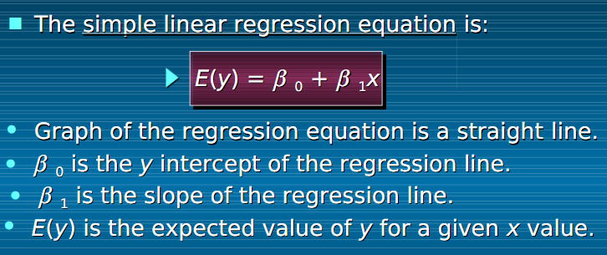
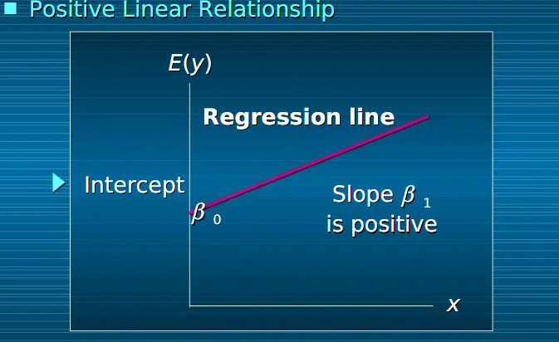
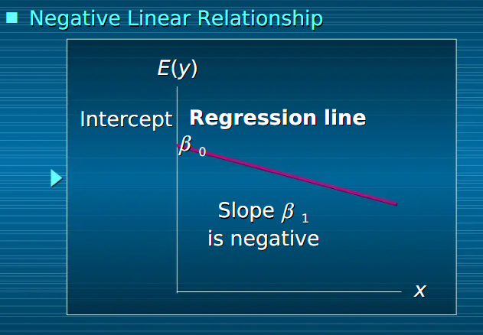
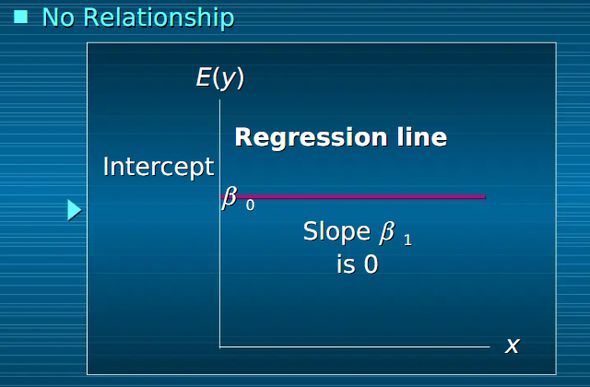
Summary of Linear Regression
Source: Thomson-South Western

Slide 5
Steps to Execute Linear Regression in R
Step 1: Load the Data
This model will attempt to fit a simple linear regression model using dividend as the explanatory variable and stock_return_scaled as the response variable.
Step 2: Visualize the Data
Before a simple linear regression model is fit on the data, the data should be visualized to get a clear understanding of it. The purpose of visualizing the data is to check that the relationship between the two variables dividends and stock_return_scaled is roughly linear or not.
Step 3: Perform Simple Linear Regression
Proceed to fit linear regression model using dividends as explanatory variable and score as response variable.
Step 4:Interpret and Analyze the results.
Based on model summary, get insights about the variables and their relationship.

Slide 6
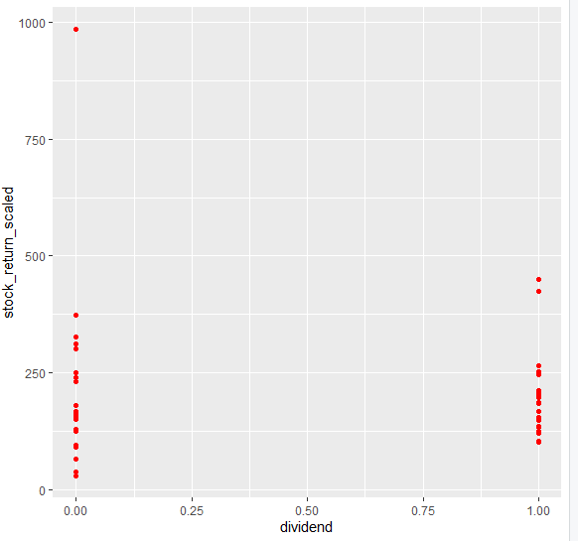
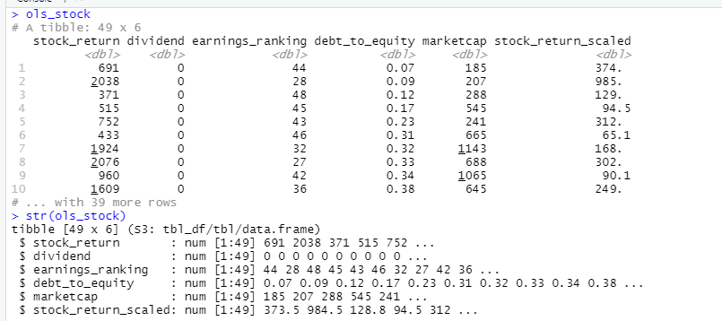
R-Code for Linear Regression
Input:
#Ho: A relationship between dividend and stock_return_scaled doesn’t exist
#Ha: A relationship between dividend and stock_return_scaled does exist
ols_stock
str(ols_stock)
#Disp vs. mpg
ggplot(ols_stock,aes(x =dividend, y =stock_return_scaled )) + geom_point(colour = "red")
Output:

Slide 7
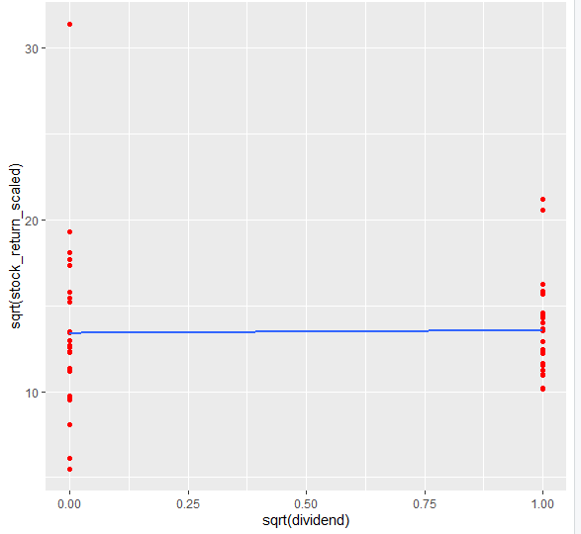
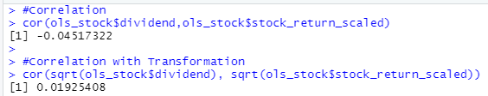
R-Code for Linear Regression
Input:
#Correlation
cor(ols_stock$dividend,ols_stock$stock_return_scaled)
#Correlation with Transformation
cor(sqrt(ols_stock$dividend), sqrt(ols_stock$stock_return_scaled))
#OLS line
ggplot(ols_stock, aes(x = sqrt(dividend), y = sqrt(stock_return_scaled ))) + geom_point(colour = "red") + geom_smooth(method = "lm", fill = NA)
Output:

Slide 8
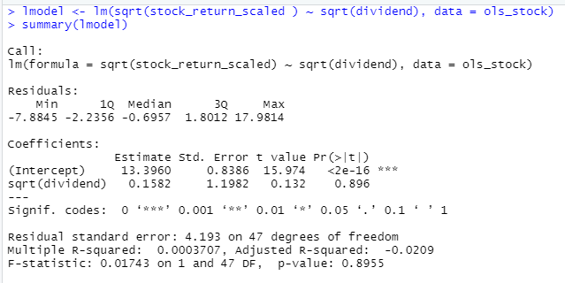
R-Code for Linear Regression
Input:
lmodel <- lm(sqrt(stock_return_scaled ) ~ sqrt(dividend), data = ols_stock)
summary(lmodel)
Output:

Slide 9
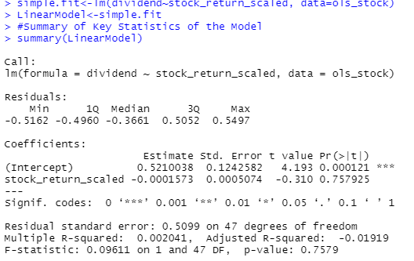
R-Code for Linear Regression
Input:
#Ho: β=0, co-efficient β of the predictor is zero and not statistically significant
#Ha: β ≠0, co-efficient β of the predictor is not equal to zero and is statistically significant
simple.fit<-lm(dividend~stock_return_scaled, data=ols_stock)
LinearModel<-simple.fit
#Summary of Key Statistics of the Model
summary(LinearModel)
Output:

Slide 10
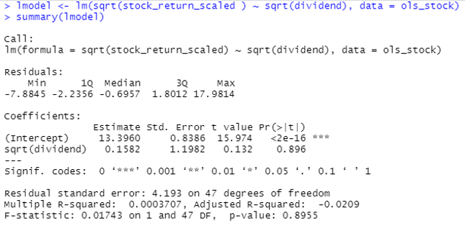
Insights gained from Linear Regression Findings
Pr(>|t|): This is the p-value associated with the model coefficients. Since the p-value for dividends (0.896) is significantly more than .001 significance level, we can say that there is no statistically significant association between dividends and stock_return_scaled.
Multiple R-squared: This number tells us the percentage of the variation in stock_return_scaled that can be explained by the number of hours studied. In general, the larger the R-squared value of a regression model the better the explanatory variables are able to predict the value of the response variable. In this case, 0% of the variation in stock_return_scaled can be explained dividends.
Residual standard error: This is the average distance that the observed values fall from the regression line. The lower this value, the more closely a regression line is able to match the observed data. In this case, the average observed stock_return_scaled falls 4.193 points away from the value predicted by the regression line.
F-statistic & p-value: The F-statistic (0.01743) and the corresponding p-value (0.8955) tell us the overall significance of the regression model, i.e. whether explanatory variables in the model are useful for explaining the variation in the response variable. Since the p-value in this example is greater than .001 significance level, our model is not statistically significant, and dividends is not deemed to be useful for explaining the variation in stock_return_scaled.

Slide 11
Insights gained from Linear Regression Findings
Pr(>|t|): This is the p-value associated with the model coefficients. Since the p-value for dividends (0.75792) is significantly more than .001 significance level, we can say that there is no statistically significant association between dividends and stock_return_scaled.
Multiple R-squared: This number tells us the percentage of the variation in stock_return_scaled that can be explained by the number of hours studied. In general, the larger the R-squared value of a regression model the better the explanatory variables are able to predict the value of the response variable. In this case, 0% of the variation in stock_return_scaled can be explained dividends.
Residual standard error: This is the average distance that the observed values fall from the regression line. The lower this value, the more closely a regression line is able to match the observed data. In this case, the average observed stock_return_scaled falls 0.5099 points away from the value predicted by the regression line.
F-statistic & p-value: The F-statistic (0.0961) and the corresponding p-value (0.75792) tell us the overall significance of the regression model, i.e. whether explanatory variables in the model are useful for explaining the variation in the response variable. Since the p-value in this example is greater than .001 significance level, our model is not statistically significant, and dividends is not deemed to be useful for explaining the variation in stock_return_scaled.

Slide 12
OLS Linear Regression
Since the P-value (0.8955) is larger than 0.001 we do not reject the Ho and conclude that relationship between dividend and stock_return_scaled does not exist.
Statistical Significance Linear Regression Test
Conclusion about Hypothesis
The P-value of the model is 0.7579 and the p-value of the predictor variables is 0.757925 which are both greater than the significance level of 0.001which indicates that co-efficient β of the predictor is zero and not statistically significant for both variables.
#Here the t-value is small and equal to -0.310, indicating that the coefficient is more likely equal to zero purely by chance.

Slide 13
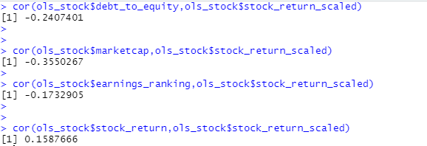
Suggested Two Variables to Increase Accuracy of Model
The other two variables I would suggest to include with dividends variable to help increase accuracy of the model is debt_to_equity variable, and marketcap variable.
These two variables are the most correlated with the dependent variable of stock_return_scaled and would increase the accuracy of the linear regression line to better predict dependent variable stock_return_scaled.
The correlation values are show below for debt_to_equity,marketcap,earnings_ranking, and stock_return with stock_return_scaled.

Slide 14
References
Week 11&12 DATA 1204 Statistical Modeling Lecture Notes
https://www.datacamp.com/community/blog/r-correlation-tutorial
https://www.statology.org/simple-linear-regression-in-r/#:~:text=%20How%20to%20Perform%20Simple%20Linear%20Regression%20in,regression%20model%20to%20the%20data%2C%20the...%20More%20
https://www.scribd.com/presentation/38291301/Linear-Regression-Analysis

